Slide 1
SOCCER PLAYER ANALYSIS
Data Analysts: Alexandr Gorbulin, Rocky Owens, and Francis Shobo
February 8, 2023

Slide 2
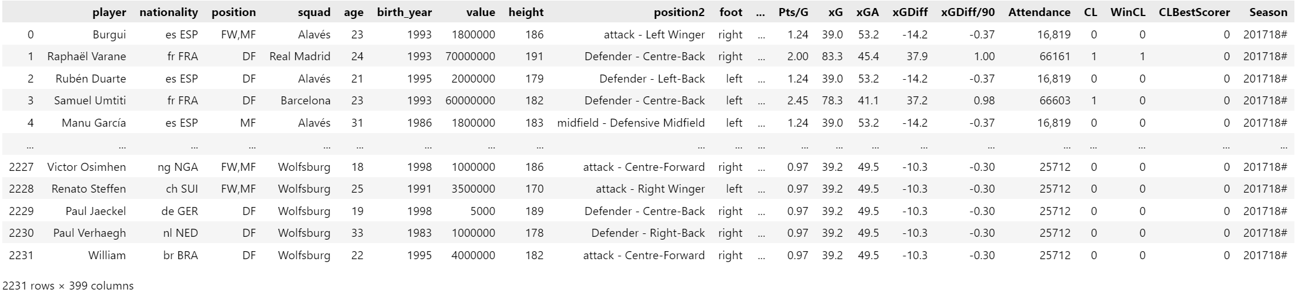
Scope & Purpose
Using a Kaggle.com merged data set from trasnfermarkt.de and fbref.com, soccer players from the top five
European leagues are analyzed using statistics to determine the relationship to player value.
The purpose of this soccer analysis is to reveal the statistics that make a player or soccer club more valuable than the others.

Slide 3
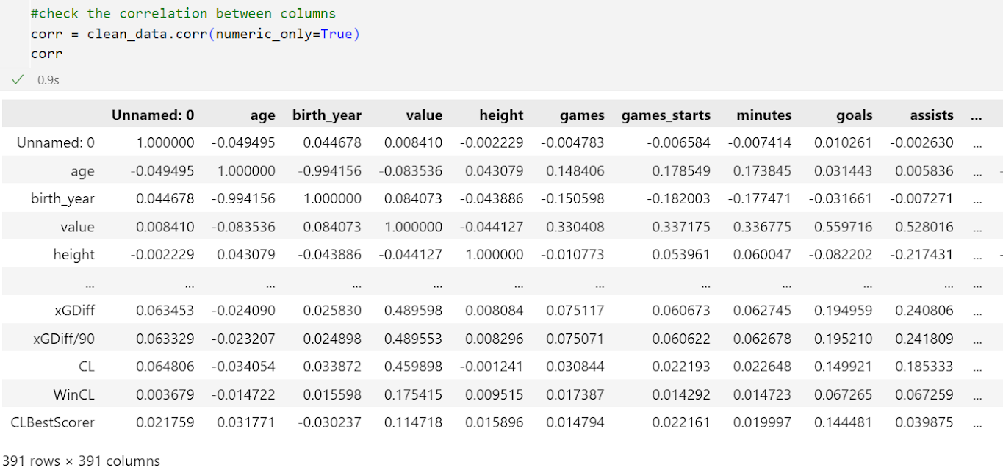
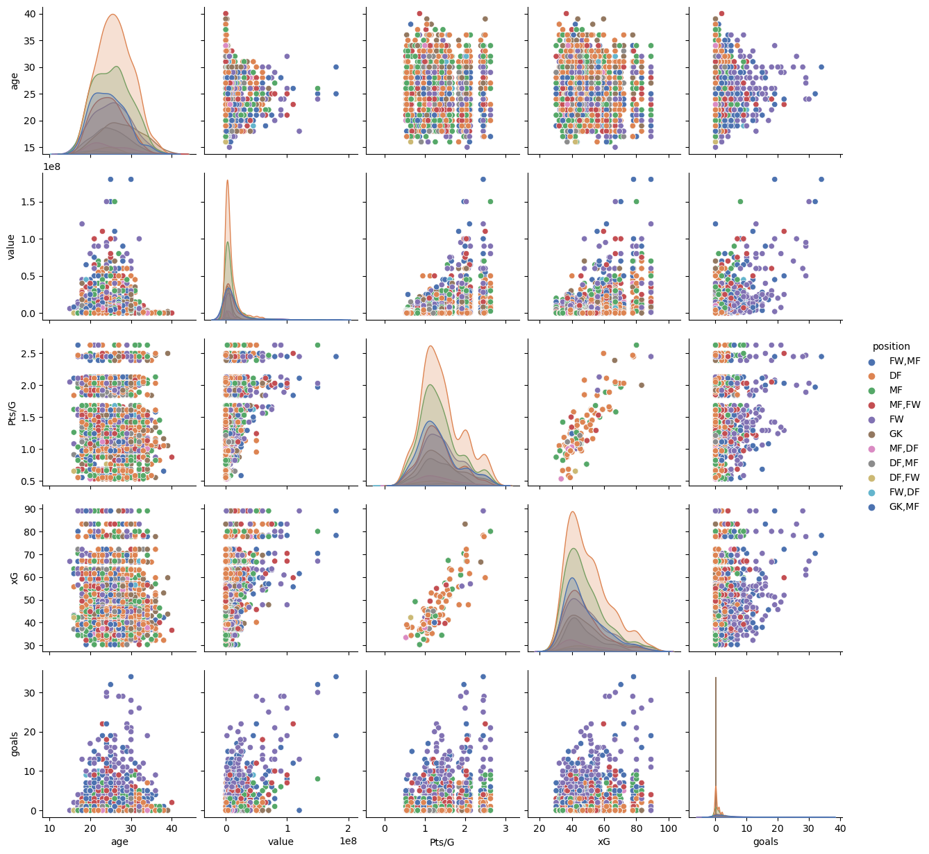
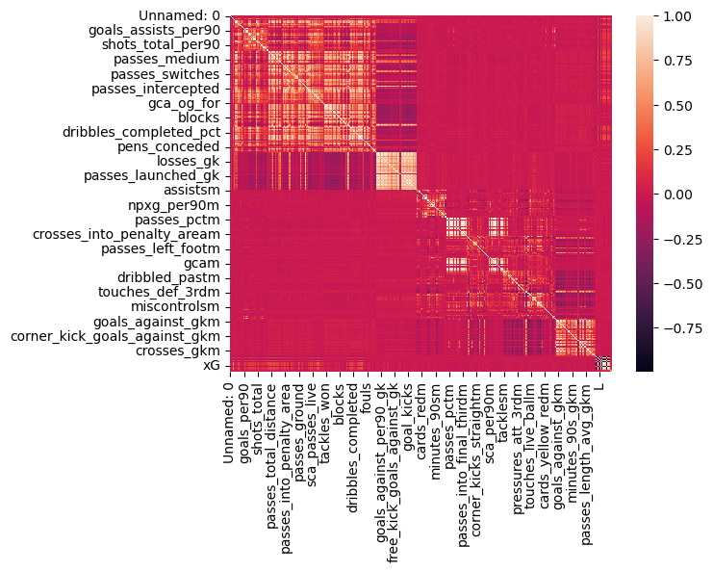
Seaborn Pair Plot – What data to use?
Correlation heatmap & Pairplot created to check for dependencies of the relationship between chosen variables.
Notes:
Pair plot created to check for dependencies of the relationship between chosen variables.

Slide 4
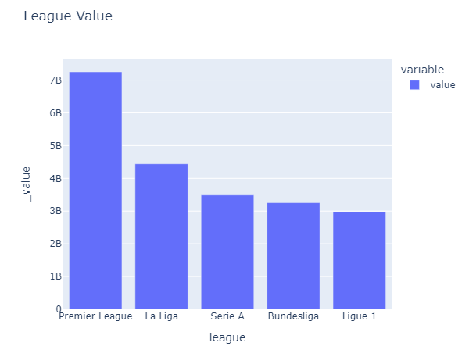
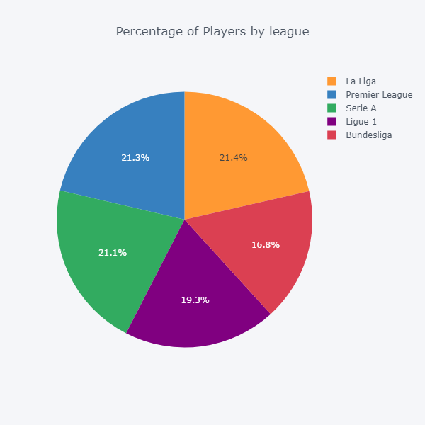
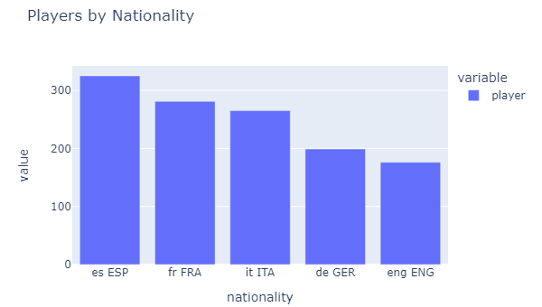
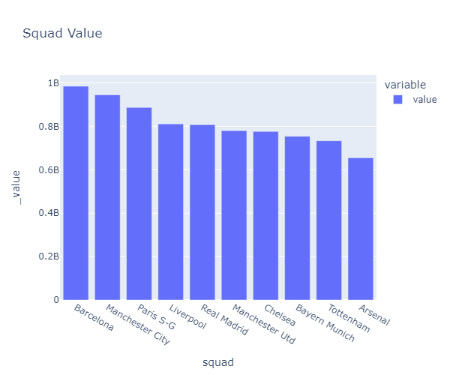
League, Nationality, and Squad Statistics
Visualizations to discover the highest value soccer league, squad, and determine the country of origin with the most players.

Slide 5
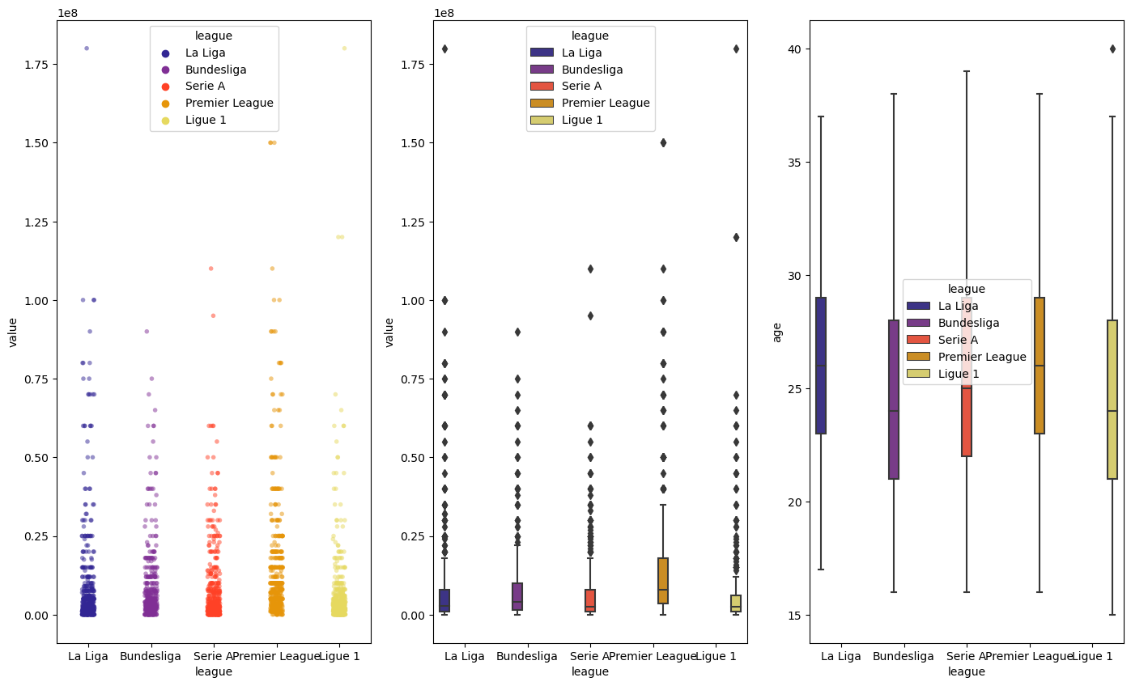
Scatter & Box Plot – Value vs. League
Scatter plot show the value distribution for each player
Middle box plot provides relationship of the value per league
Right box plot show the age distribution across the leagues

Slide 6
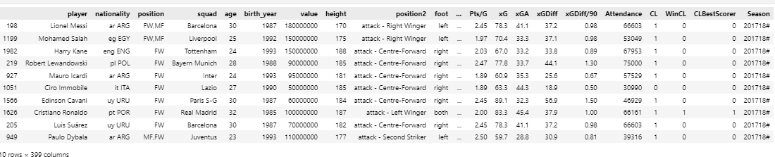
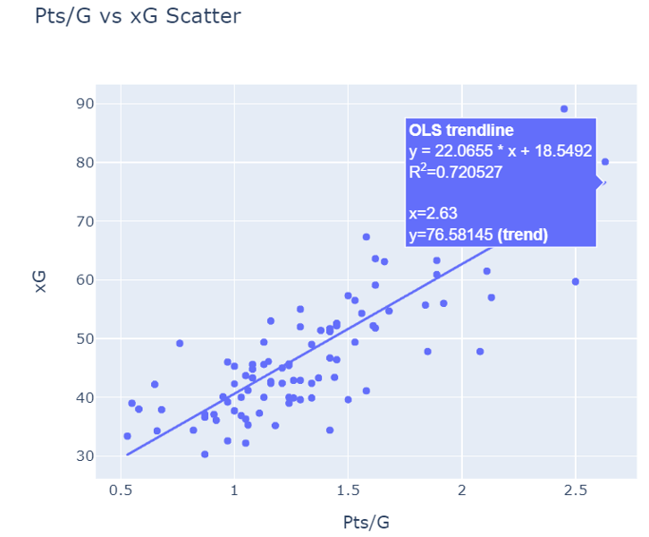
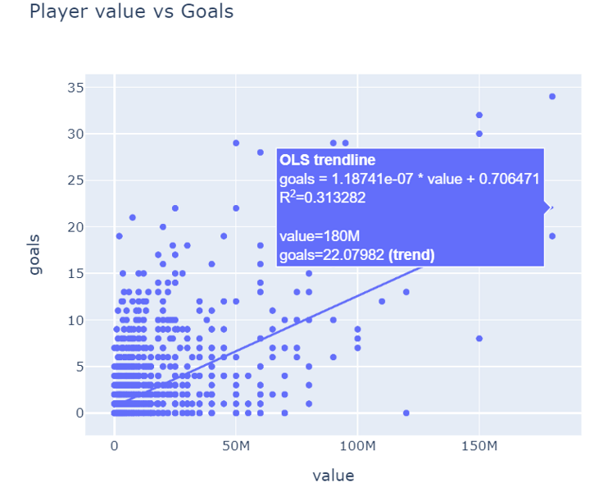
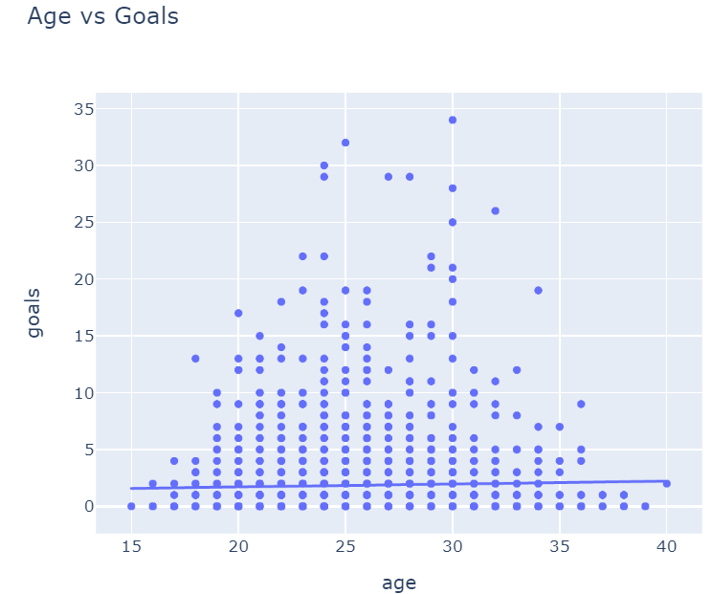
Player Goal Statistics
t-statistic: 177.92156247083068 p-value: 0.0
t-statistic: 27.163586450073577
p-value: 1.6921283697150687e-150
t-statistic: 197.72396036367533
p-value: 0.0
Notes:
Highlight the importance or value of the parameters used to identify top 10 players. For example if to put value of the player in the first place the table will show one list of players, if to put number of goals then list will be different. A small p-value indicates that the difference between the sample means is statistically significant and suggests that the null hypothesis can be rejected.

Slide 7
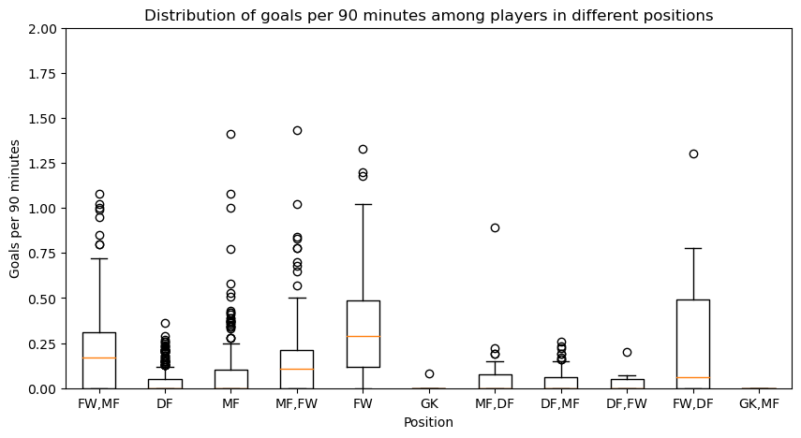
Goal distribution per Player Position

Slide 8
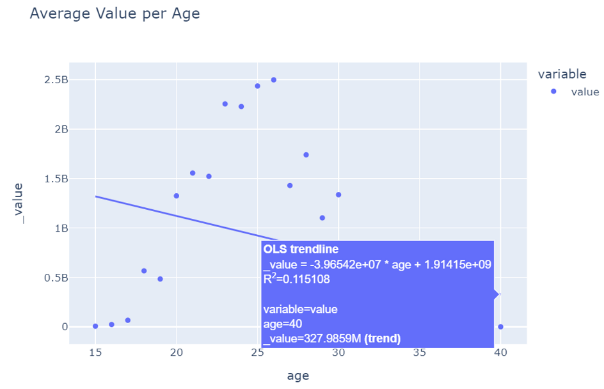
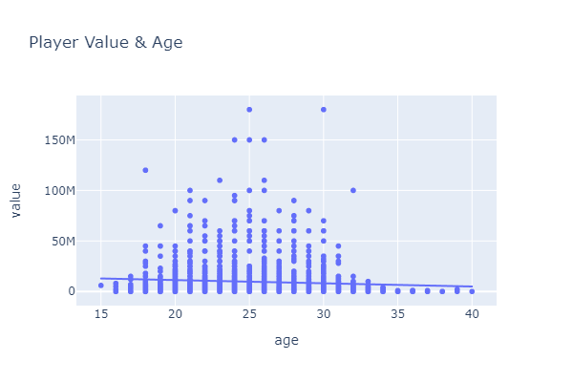
Player Value & Age
Our analysis concluded that on average soccer players at the age of 25/26 are at their highest value of their career.
t-statistic: 27.163519717041616
p-value: 1.6947658895243164e-150

Slide 9
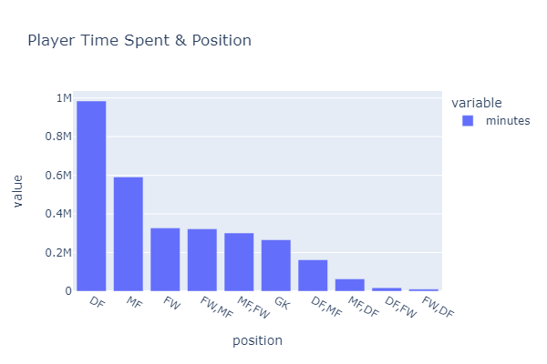
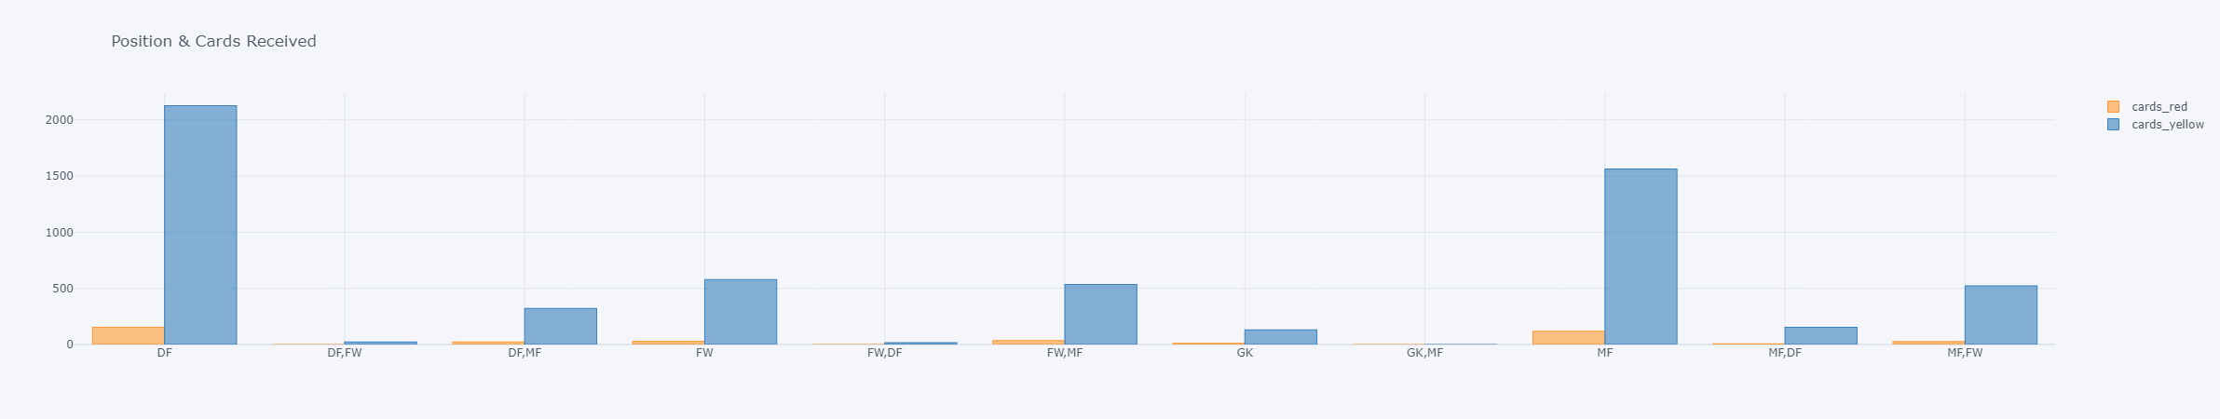
Player Position & Cards Received
Visualizations to determine which positions logged the most minutes on the pitch as well as the amount of penalty cards received by each position.

Slide 10
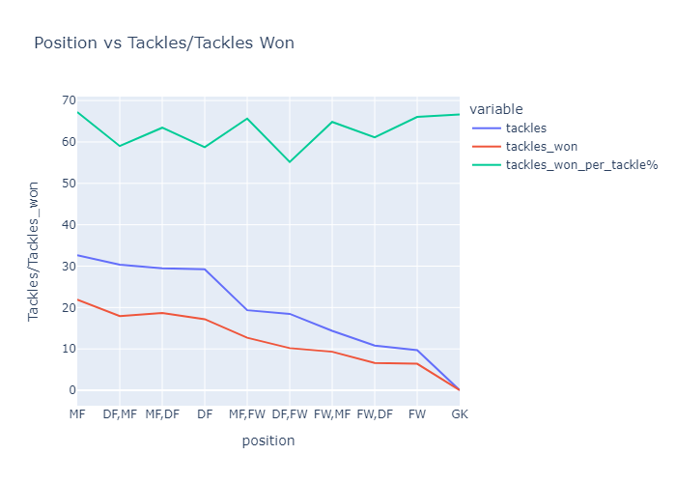
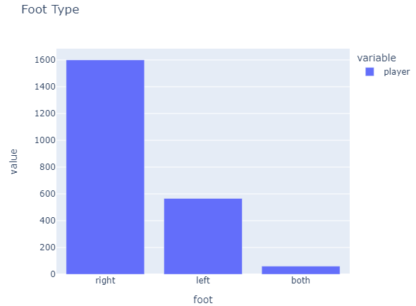
Tackles vs. Tackles Won
Visualization of position tackles vs. tackles won translated to show MF and DF percentages.
The analysis can begin to show less valuable categories, such as player foot preference, which although telling does not correlate to player value.

Slide 11
Analysis & Conclusions
The league with the highest value is Premier League at over $7.25B.
The percentage of players is distributed evenly across the leagues at near 21% even though the other leagues are only 60% or less of Premier value.
Barcelona is the highest value squad at almost $1B.
Spain has the most players in the leagues with 15% - 325 of 2117 players.
T-Test analysis showed data significance since the p-value is very low (<0.05)
FW/MF positions have the highest goal distributions.
A player’s peak age of value is at 25/26 then declines.
DF position plays the most minutes and receive the most penalties.
Not all analysis is beneficial, as in 75% right foot preference.

Slide 12
THANK YOU!

